Slide 1

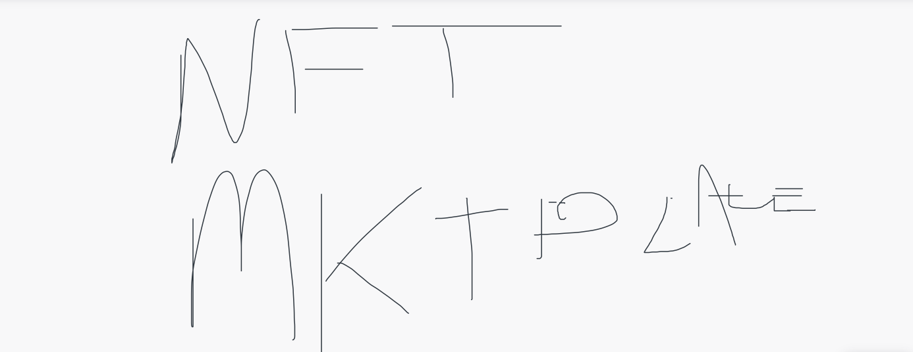
TEAM MEMBERS:
Kelvin le
Juan bohorquez
Ethan Rosenberg
Jaime villafuerte

Slide 2
Intro:
An examination of NFTs in the current Fintech world.
Technology used to develop our NFT Market token development.
Technology used to test our code.
Results and conclusions

Slide 3
NFTs in Fintech
It is no surprise that In the world of Financial Technology (Fintech) new tech is developed to improve and automate the delivery and use of financial services. With it comes new development of currency, cryptocurrency, designed to act as money a form of payment removing the need for third-party involvement.
The popularity of non-fungible tokens (NFTs) has skyrocketed since 2017 and evolved into one of the most favored concepts in the blockchain ecosystem.
In 2020 the NFT market achieved a sensational value worth of $2.5 billion.

Slide 4
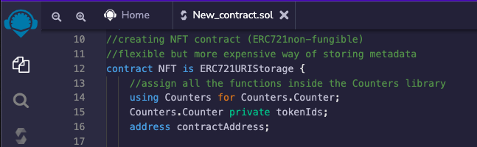
Technology used: Remix IDE
We used Remix IDE an open-source web application. Mainly used for the development of contracts with Solidity while using Ethereum enabling smart contracts and applications built on its blockchain.
The snippet code shows the development of a contract NFT using ERC721Storage while using Counters library to store further functions.

Slide 5
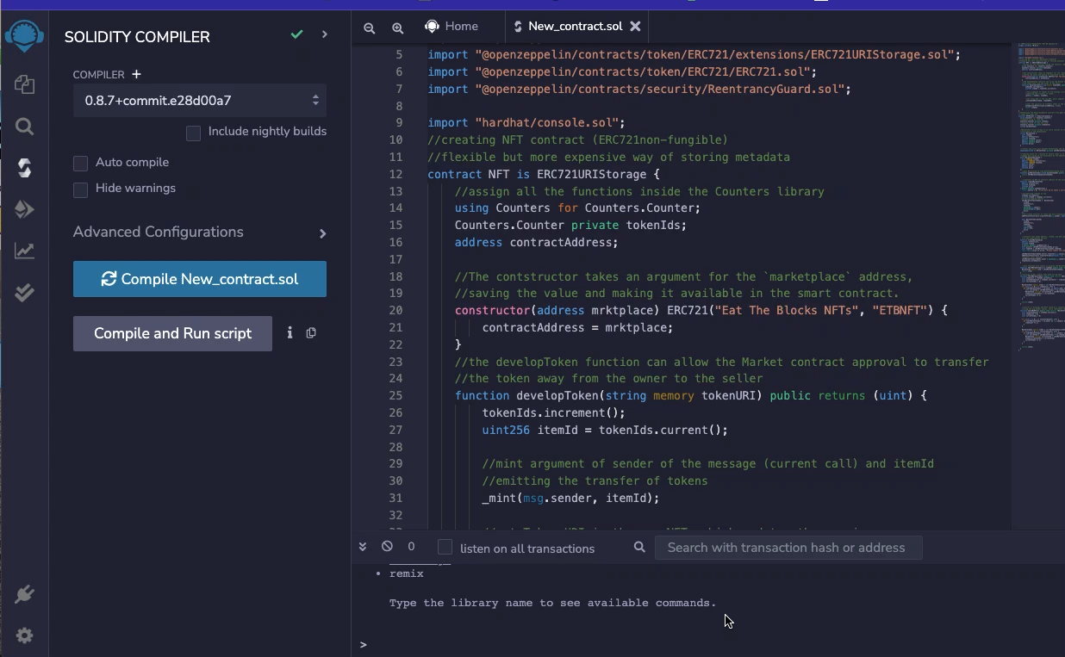
Remix New NFTmarket compile

Slide 6
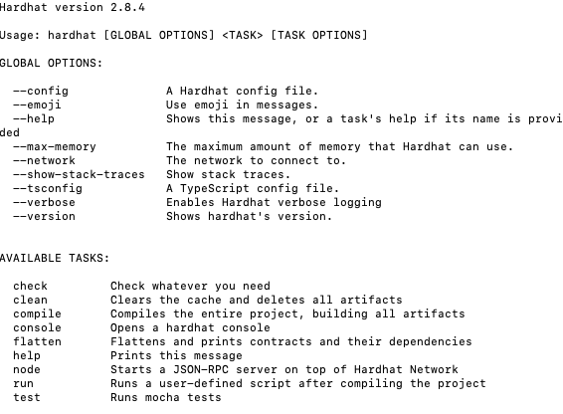
Test NFT market contracts:
Hardhat Environment
Hardhat environment is used to test, compile, deploy and debug dapps based on the Ethereum blockchain.
Main issue was understanding Node.js to create the web-server and networked applications for our front-end application before deploying Hardhat.
But after many hours and trial and error we got it working.

